Slide 1

The IEM and other things that should interest the audience
Daryl Herzmann
@akrherz
Iowa State University
Notes:
Here we go!

Slide 2
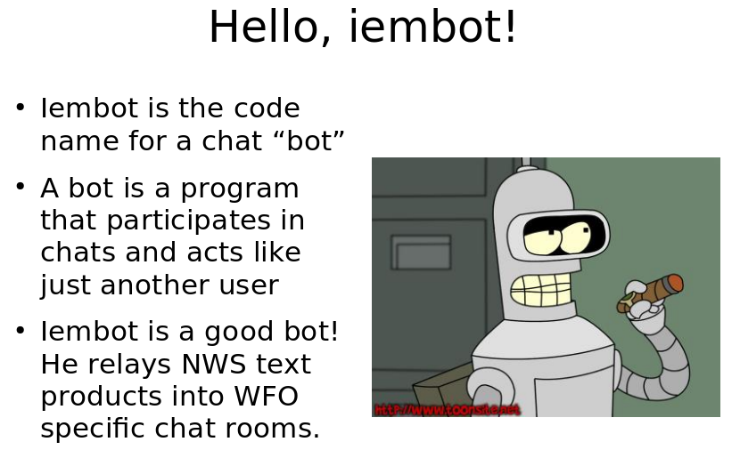
Last I spoke with CR SOO’s, 2007!
Shamelessly promoting IEMChat -> NWSChat

Slide 3
My Unabridged History
1978-1997 Grew up on dairy farm in NE Iowa frustrated by weather forecast for 3 days of dry weather when we’d mow hay only to have it rain.
2001 Got a BS in Meteorology from ISU, went home for a week to chop wood, came back to run the IEM.
2005-2017 Moonlighted on various NWS tasks including NWSChat, sigh.
2002-2020 Presented IEM stuff at ~20 NWS Offices, including IND. Your office could be next!

Slide 4
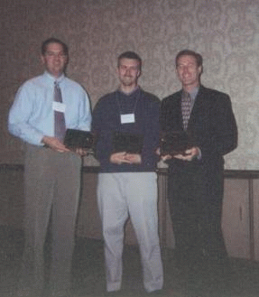
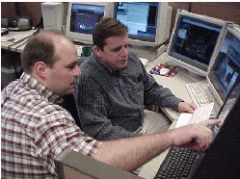
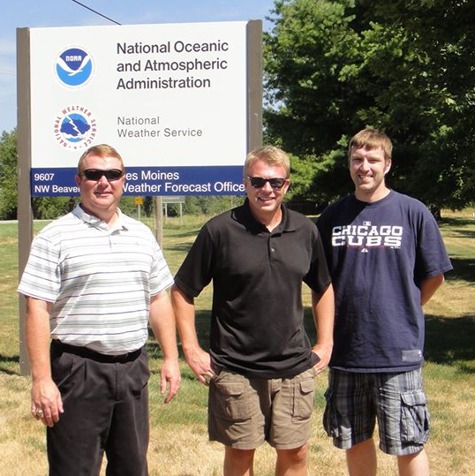
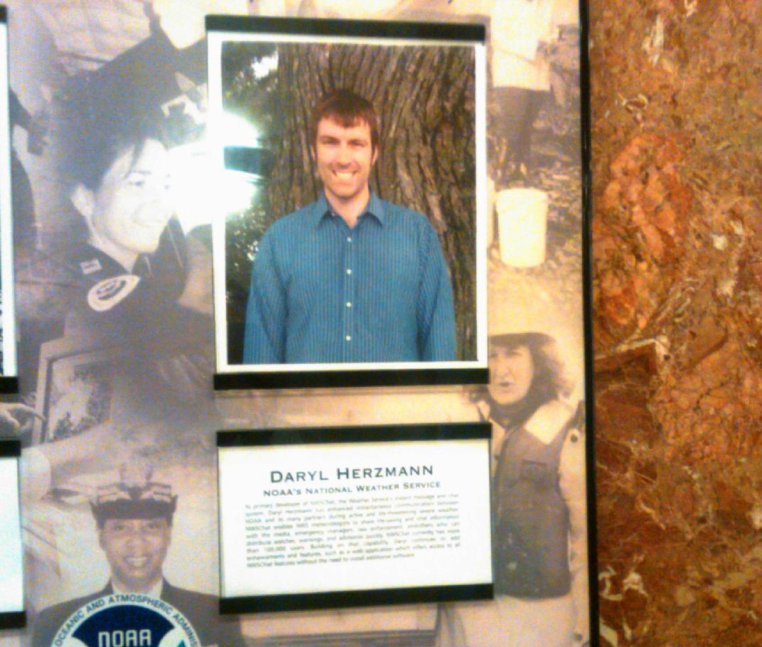
Precious Memories…

Slide 5
Talking Points Memo
Naming things is hard
About the “Iowa” in my website’s name.
Web resources should have stable URIs!
Email says: “Please implement X”, me: “Sure”.
The IEM Website ranks second worst organized weather website.
So I am here, attempting to make sense of the chaos on the website, and shameless self promote tools that should make your life easier.

Slide 6
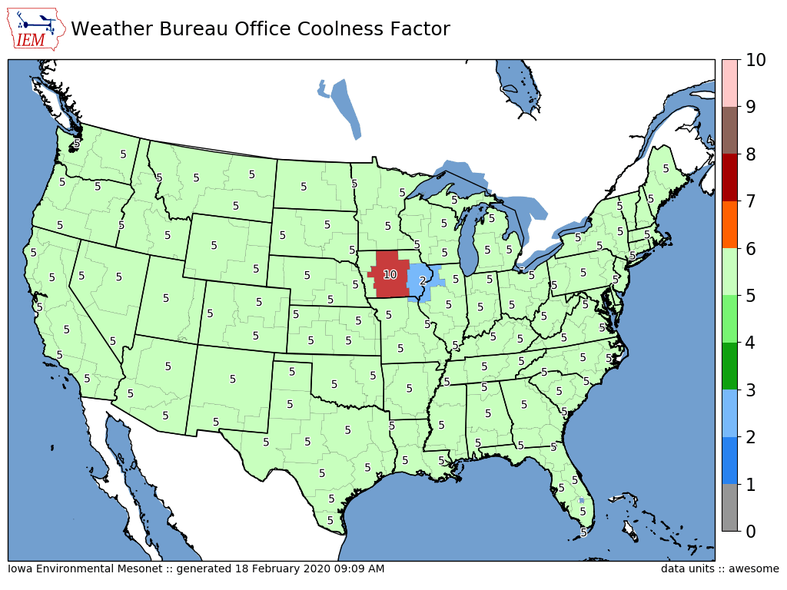
Purpose of my maps is not to show good/bad offices, but show local gradients

Slide 7
Websites of interest: https://mesonet.agron.iastate.edu https://mtarchive.geol.iastate.edu
~ 300 TB of “live” data on scrapable trees
~ 10 TB of database information fronted by various web services
~ 200 million web requests per day from about 200,000 unique IPs (Link)
~ 30 servers over 3 datacenters.
Ufffff, what a mess I have created!

Slide 8
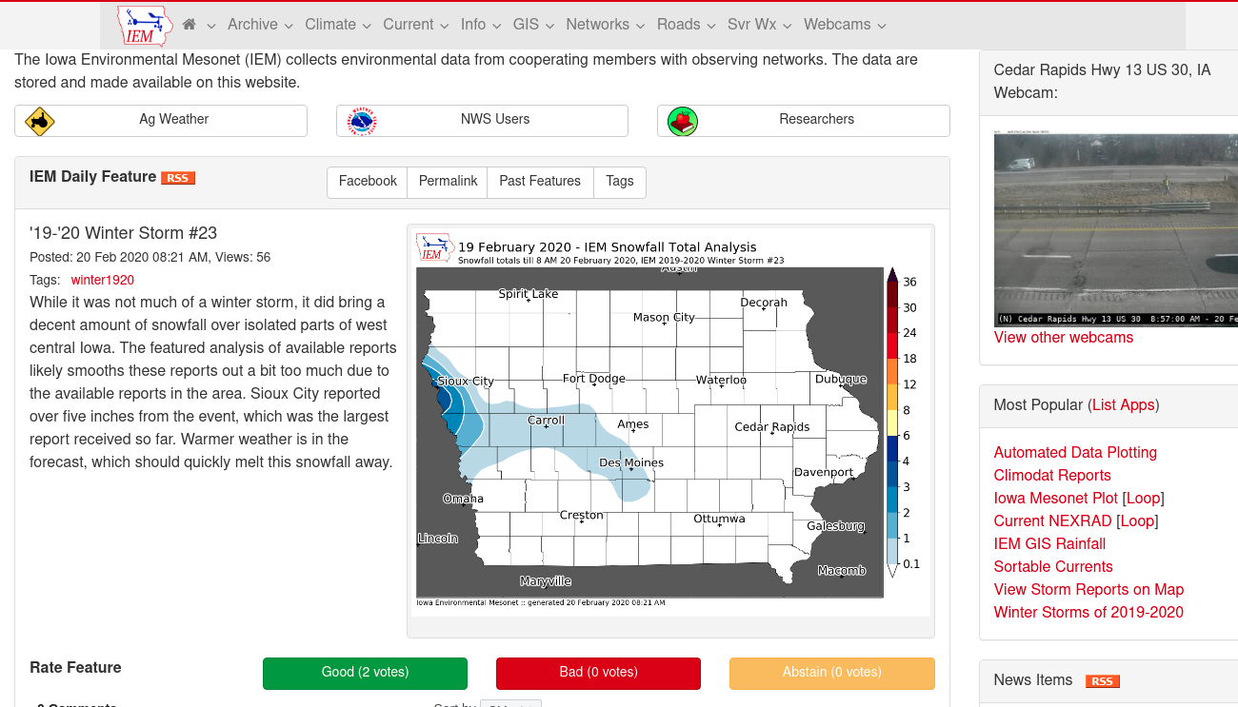
The IEM Website in its text-heavy glory.

Slide 9
Datasets Curated (or how many abbreviations fit on one slide)
Text MOS
Global METAR
Soundings
PIREPs
NWS Text Archive
ASOS 1 Minute Data
SHEF HADS/DCP/COOP
Iowa+ Webcams
SPC MCD/Watches/Outlooks
SIGMETs
HML (River Stage Forecasts)
Handful of NCEP F000 Models
RTMA
Various Iowa-Only Observations
NEXRAD Level II Live Data
Archive the NWS “WaWA” Map
NLDN (Not Public)
NRCS SCAN
USCRN
Public RWIS Networks
SMOS Satellite (Midwest)
RADAR Products
MRMS
Flash Flood Guidance
Local Storm Reports
VTEC WaWA
MADIS / “HFMETAR”
15minute Fisher/Porter
Bufkit Profiles
CLI Data
Let us discuss more those highlighted in yellow.

Slide 10
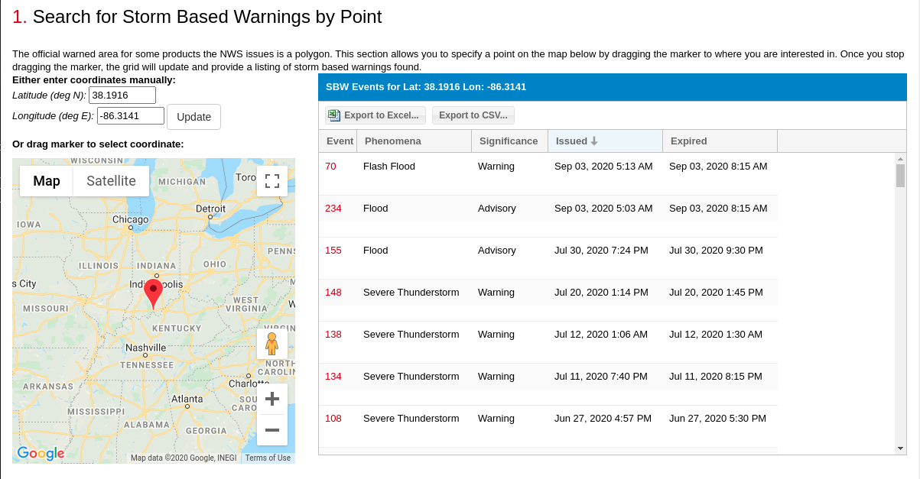
SBW Polygon Search by Point (Link)

Slide 11
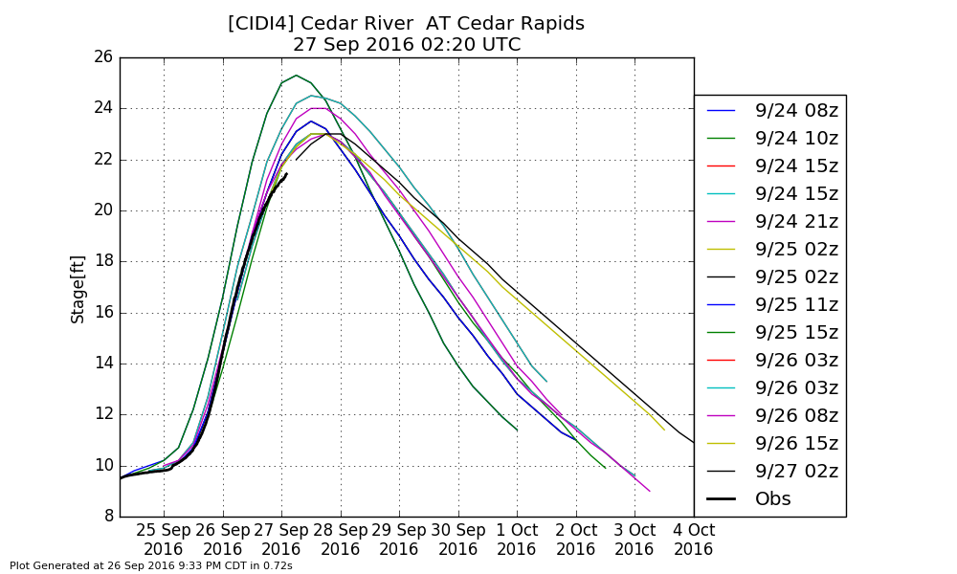
HML Obs/Forecast Archive (Link)
Archive all of the stage observations and forecast found in the HML product
Autoplot 160 can plot these and offers a spreadsheet download

Slide 12
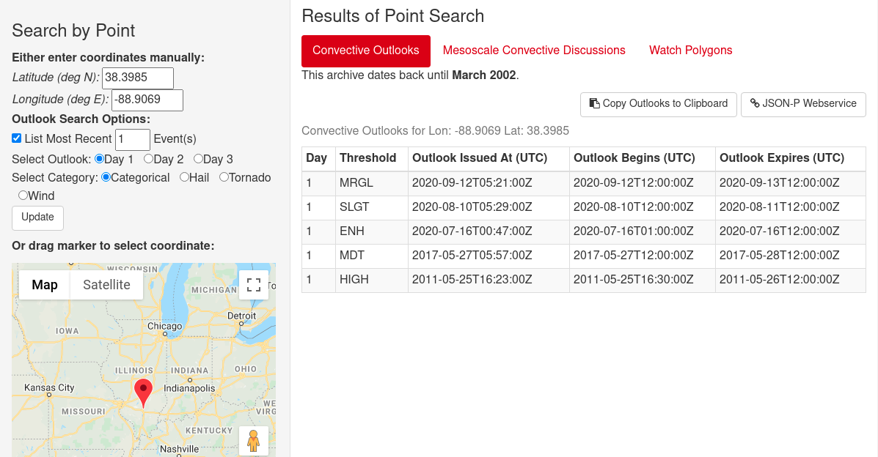
SPC Outlook / MCD / Watch Search by Point (Link)

Slide 13
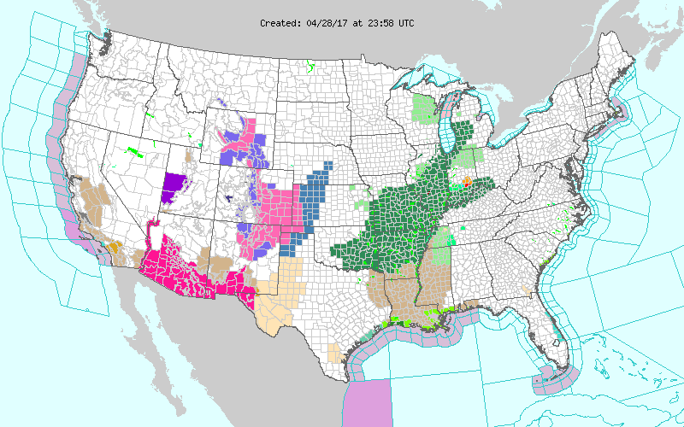
Archive of the weather.gov “WaWA” map since 2013 every 5 minutes

Slide 14
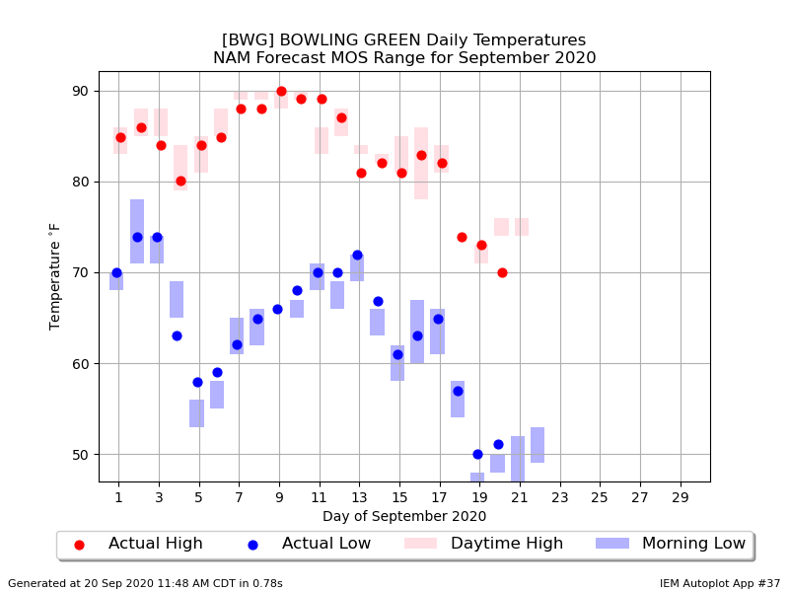
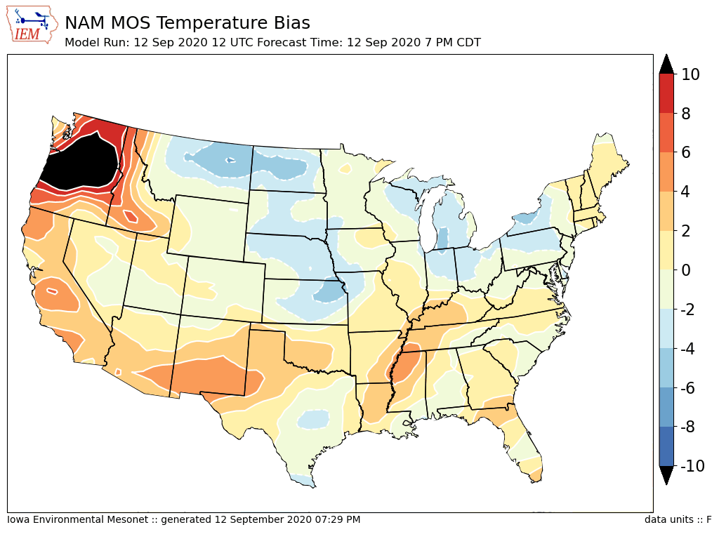
Archive Point/Text MOS - Can download spreadsheets of data
“Autoplot 37”
Link

Slide 15
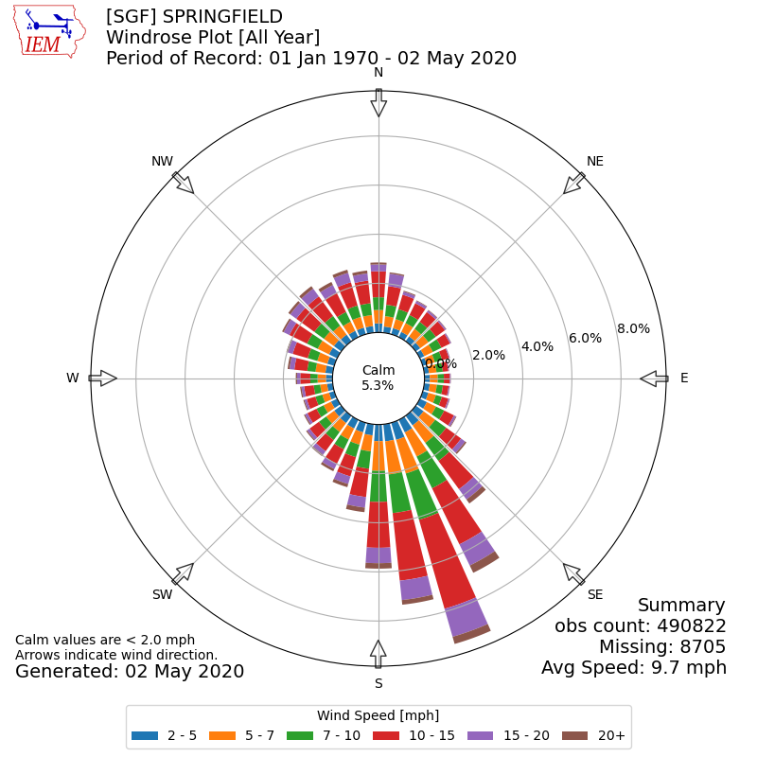
ASOS/METAR Archive
Lots of Global METAR data (billions of obs)
Lots of apps to summarize it
Windrose Link
Download Link

Slide 16
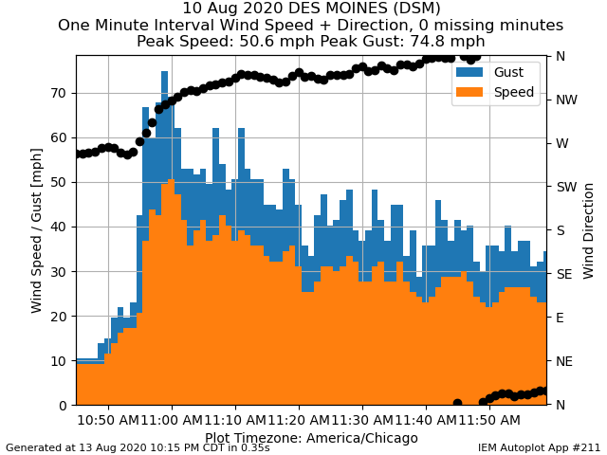
ASOS 1 Minute via NCEI
Daily processing what NCEI provides for 1 minute ASOS data
Archive back to 2000.
12-48 hour unavoidable delay for availability
Download Link
Autplot 211

Slide 17
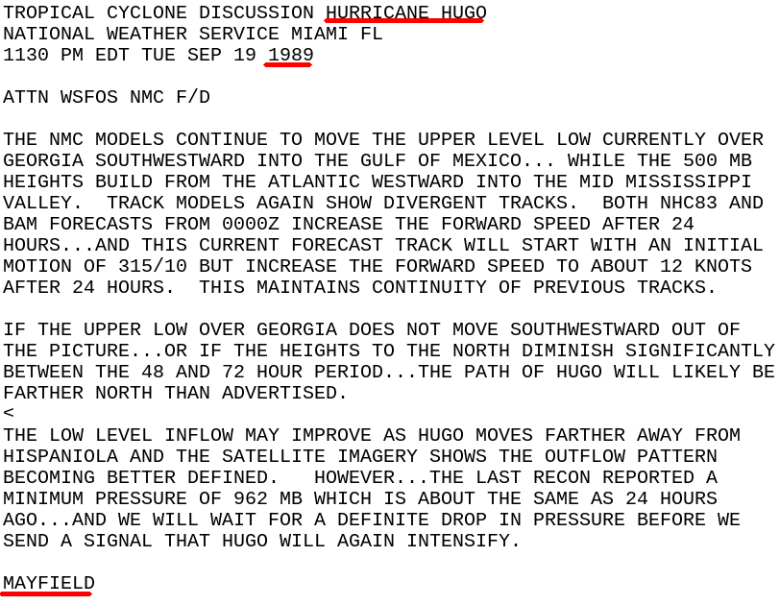
NWS Text Products back to 1983!
My most satisfying data to make public!
Gold mine!!!
Old WMO sources, centers, WSOs are stored using present day WFOs, etc.
Hit me up for custom queries, like finding forecaster’s first signed product.
(Link)

Slide 18
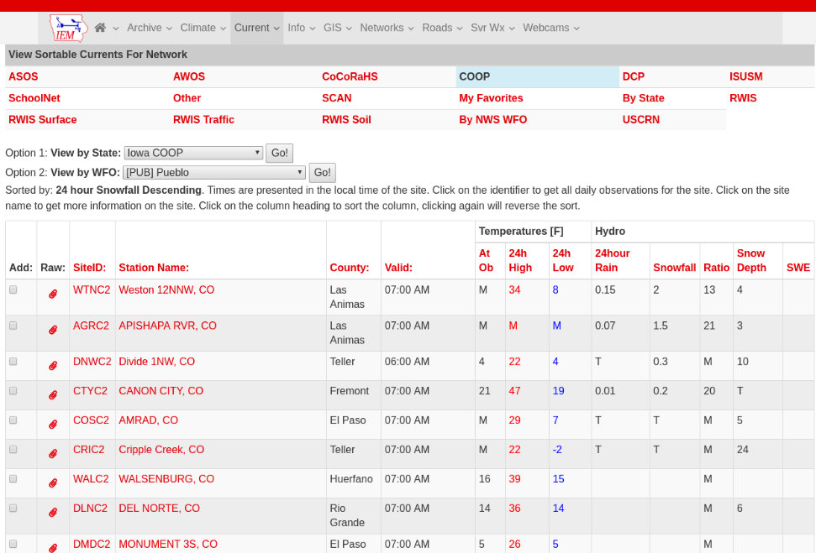
COOP Reports by WFO
Realtime processing of SHEF data
Sortable columns
SWE reports are included
Snow/Precip ratio is computed for QC help
Click on NWSLI to get all reports for the year
(Discuss DCP vs COOP)

Slide 19
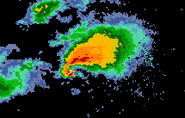
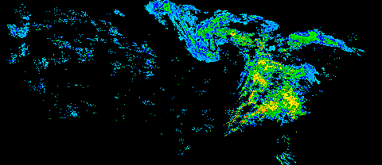
NEXRAD Archives
1km composite every 5 minutes back to 1995
Single site imagery since 1 Jan 2012
Iowa NEXRADs are backfilled to mid 1990s
GIS Ready!

Slide 20
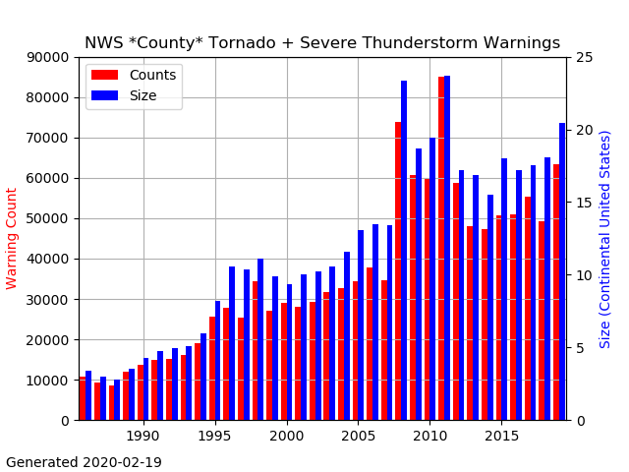
NWS County SVR/TOR Warnings
Storm Based Warnings
NEXRAD

Slide 21
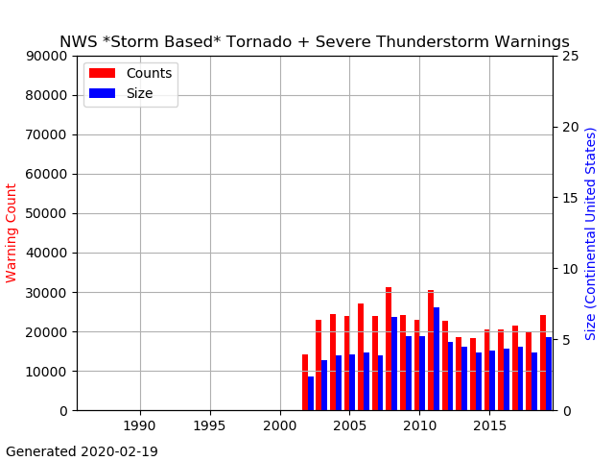
NWS SBW SVR/TOR Warnings

Slide 22
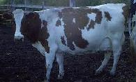
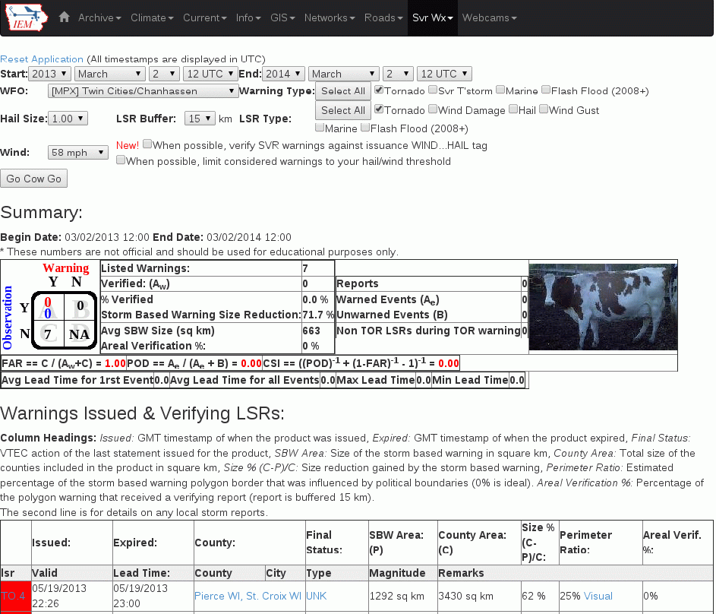
IEM Cow
SBW Verification based on Local Storm Reports, not Storm Data
Provides geometry stats on polygon
Handy way to review event data
It is ‘live’ and accurate at the time of page load

Slide 23

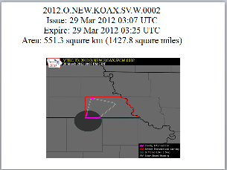
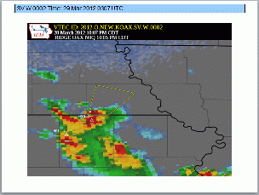
IEM Raccoon
OAX’s Dan Nietfeld gave me the idea
Create simple and quick Powerpoints of SVR,TOR warning events
Intended use:
Internal Office review of events
Quick materials for presentations

Slide 24
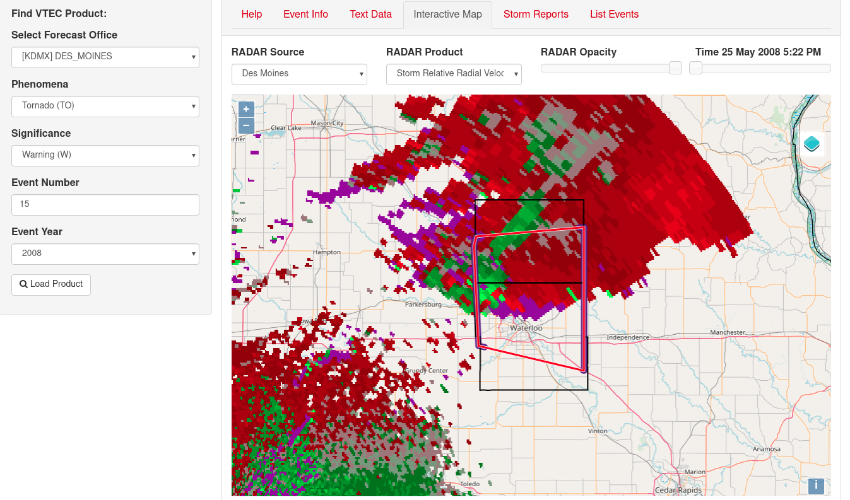
VTEC Browser

Slide 25
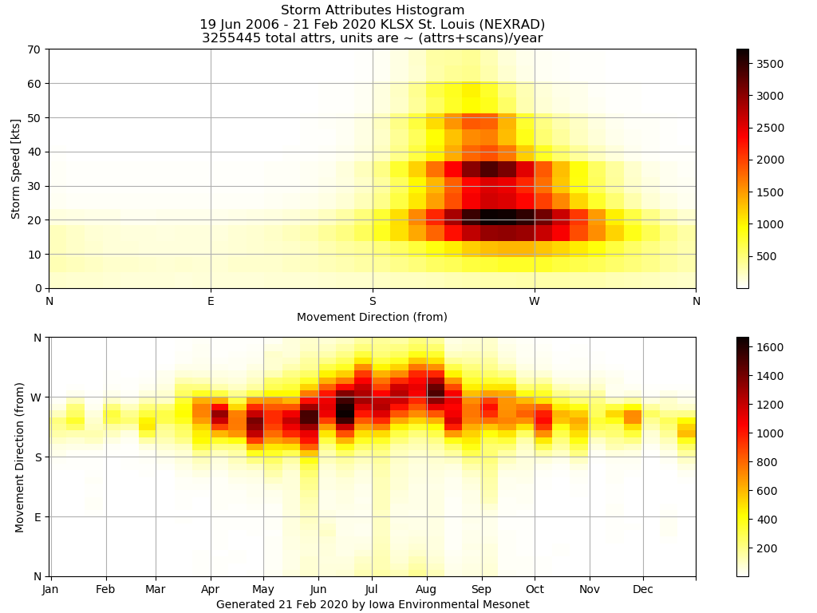
NEXRAD Storm Attribute Archive (Link)

Slide 26
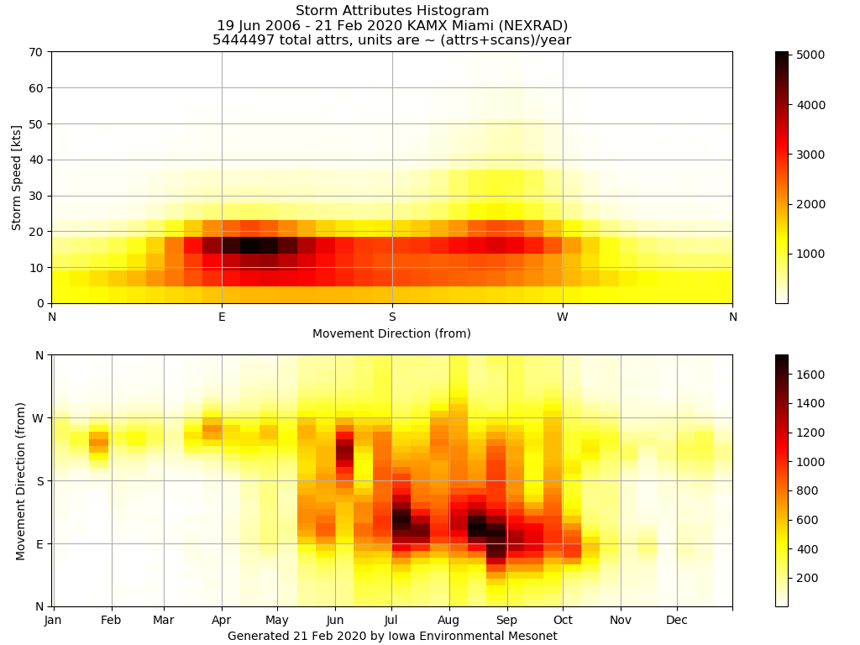
For comparison, here is Miami

Slide 27
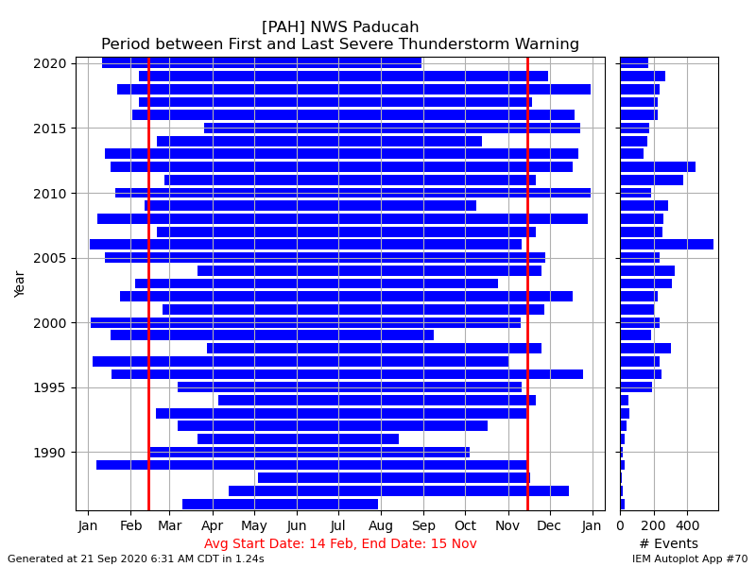
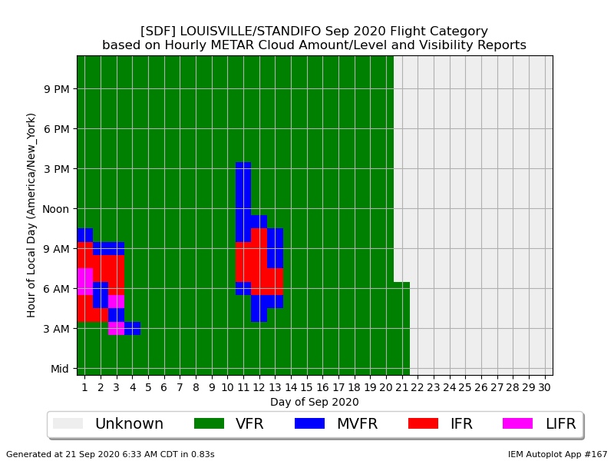
“Autoplot” application ~210 Plot Types
Autoplot #70 (Link)
Autoplot #167 (Link)

Slide 28
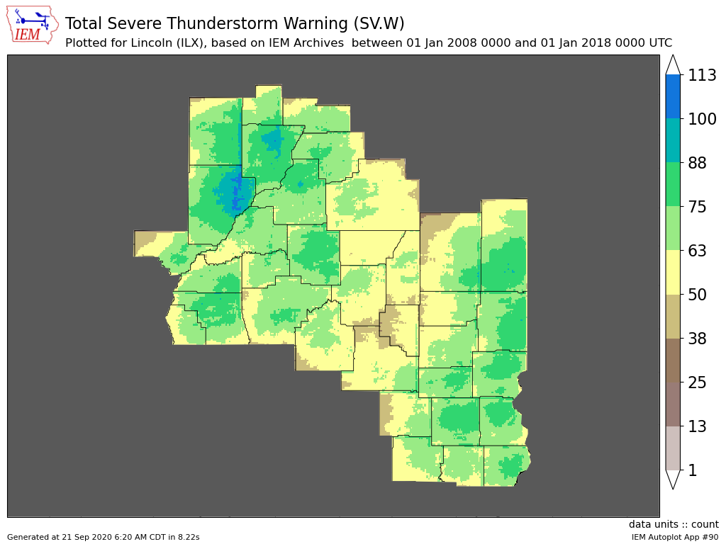
Autoplot #90 (Link)

Slide 29
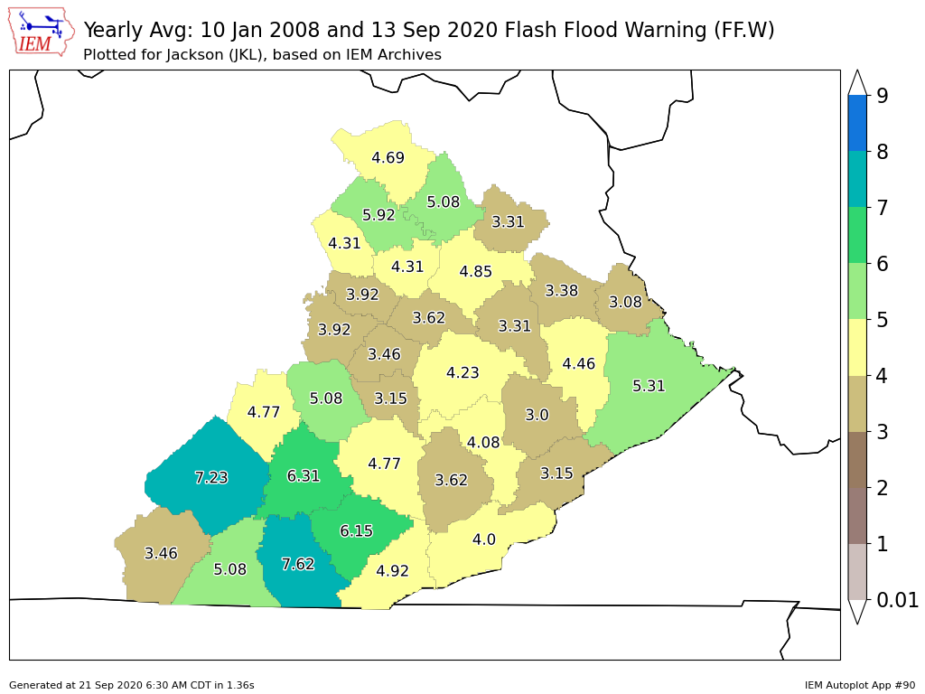
Autoplot #90 (Link)

Slide 30
My Standard Last Slide
Hopefully NCDC NCEI puts me out
of (my misery / business) someday!

Slide 31

Time for Questions? PPT: IEM Website -> Info -> Presentations
mesonet.agron.iastate.edu
Daryl Herzmann
515.294.5978
akrherz@iastate.edu

